Slide 1
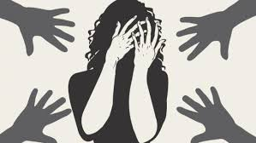
An analysis on criminal activities in Bangladesh
This analysis contain the criminal offence like murder ,rape, house breaking house trespus like offences which continuously increasing day by day in Bangladesh .

Slide 2
This project contains the information about crimes in Bangladesh and collect data regarding last few years
Murder
Rape
murder refers to kill someone without any lawfull authority .
murder can also be considered as killing.
extra judicial killing also considered as murder which occur in the police custody .
Rafe refer to the unwilling sexual intercourse with someone .
element of rape contains panitration ,forced ,unwilling intercourse
it can also be marital rape though it is not applicable in our country .

Slide 3
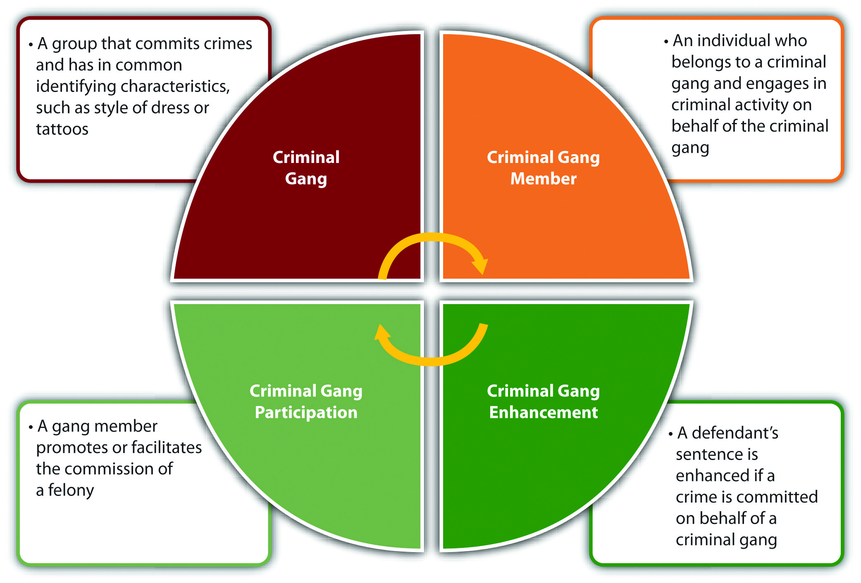
Here is a chart of criminal activities in Bangladesh

Slide 4
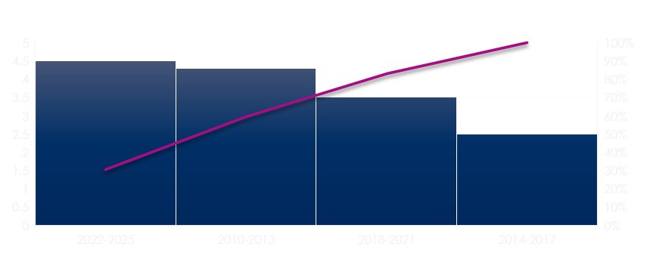
A chart shows crime rate in bangladesh

Slide 5
This chart shows that in a very shoert time how gthe criminal rate of our country increasing . When in 2014 to 2017 the criminal rate in this country was only 40 percent but in just 3 years difference the criminal rate increase approximately 30 percent which is 70 percent The rate of murder and criminal misreprasentation are increasing in a notisible amount .
Finding the reason why the such amount of increasing criminal activities some social scholers found that poverty ,anger ,illetarate are the most important reason for such type of criminal activities .
They also found in last few decade the rate of criminal activities increased rapidly . It behave like a time bomb ,with in a few years it make a terrorist area whole of the Bangladesh

Slide 6
Criminal behaviour
Criminal behaviour refers to such of the behaviours that prohibited by any law or any provision of any law .
Law may sometimes omits any act or support to do any act which is considered as lawful act but which is extra judicial and without the lawful authority is a illegal act .
The legality and illegality are found by the law and the provisions

Slide 7
Activities supported by the law and the provisions are call lawful act
Act and omission are two legal issue of law .act means ant act which law prefer to do by the citizens
Omission refer to such act which any law by its provision direct not to do
Act means do
Omission means not to do
ACTIVITIES NOT SUPORTED BY THE LAW OR THE PROVISIONS OF THE LAW ARE CALLED ILLEGAL ACT

Slide 8
THANK
YOU

